Slide 1
Lightweight assistive technology: A wearable, optical-fiber gesture recognition system
Sanjay Seshan Fox Chapel Area High School

Slide 2
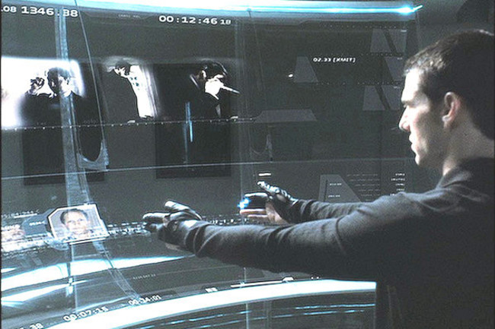
Objectives
18 years ago, a movie called Minority Report was first to introduce the world to a gesture-based interactive device.
Though common in science fiction and comic book movies, it is yet to become reality.
The goal of this project it to build a lightweight, low powered method to interact with computers around us
The computer will recognize a wide range of hand gestures
Does not require the use or special gloves or other intrusive hardware
Notes:
Minority report

Slide 3
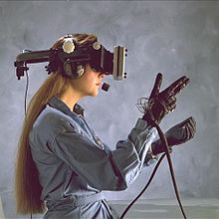
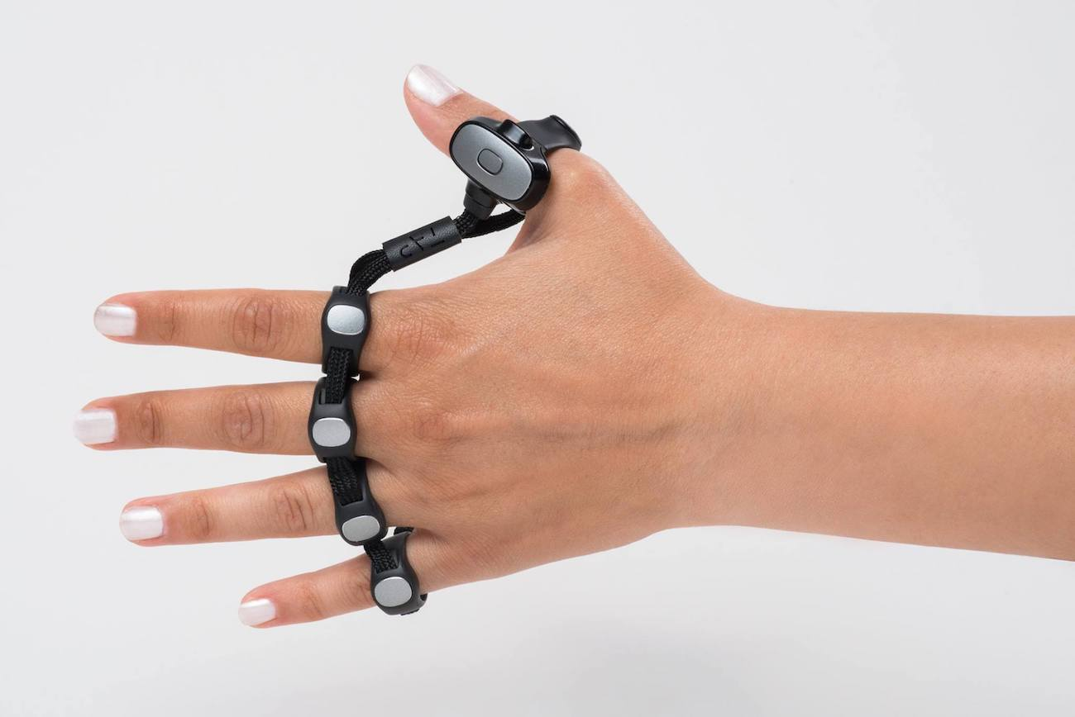
CURRENT methods VS. REquirements
Current methods are
Intrusive and cumbersome to wear (unnatural positions) - Tap and other devices are uncomfortable and hard to put on and take off
Cyber glove
Impractical – camera may not face the wearer, Google radar system is also off-body
Must be wearable
Must be non-intrusive
Must be intuitive
Must be lightweight
Must be low-powered
Notes:
https://en.wikipedia.org/wiki/Wired_glove
https://www.youtube.com/watch?reload=9&v=mpbWQbkl8_g#t=810
https://towardsdatascience.com/training-a-neural-network-to-detect-gestures-with-opencv-in-python-e09b0a12bdf1
READ: https://www.wired.com/story/how-i-became-a-robot-in-london/

Slide 4
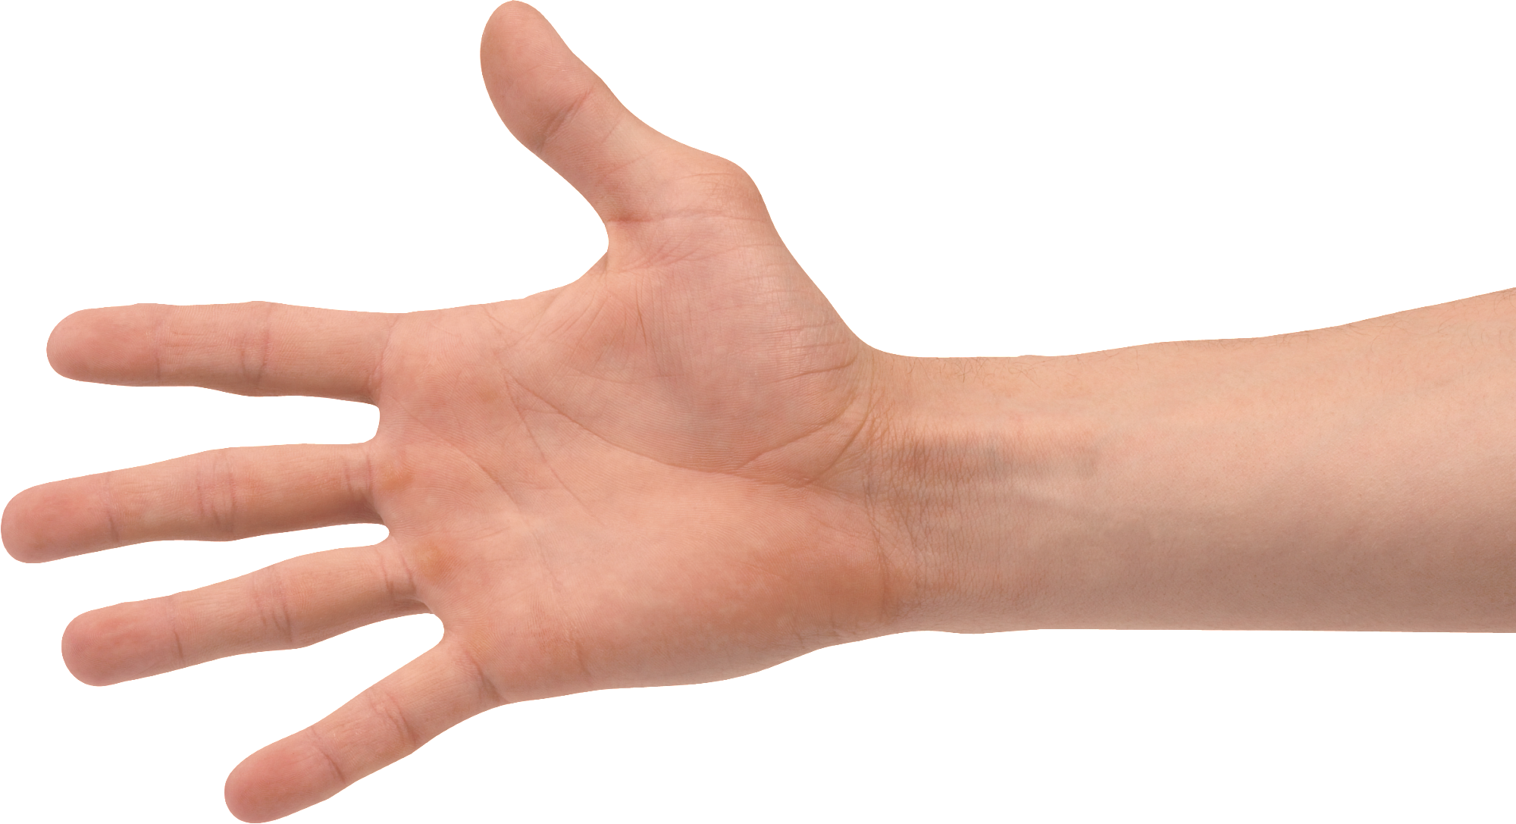
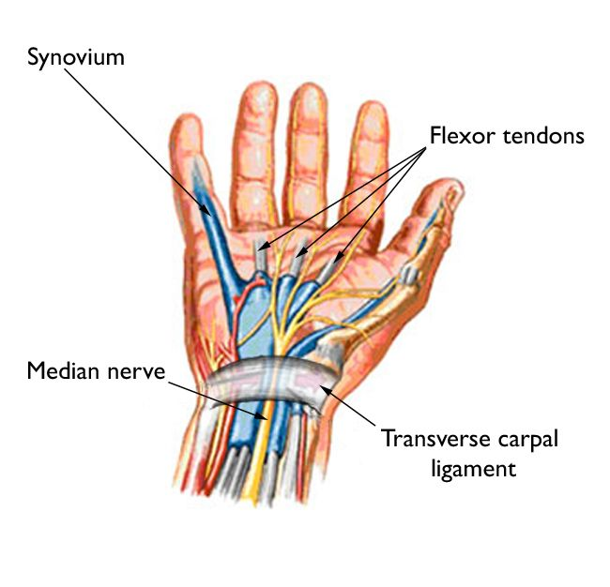
Solution:
OPTIAssist: Optical Fiber Based Lightweight Assistive Technology
Strap around the wrist
1 in 6 adults own a smart watch
Use optical fibers as sensors along the strap to detect deflection
Transverse carpal ligament area
Deflection occurs when fingers [tendons] are moved
Magnitude of deflection of different tendons can be used to identify gestures
6 different tendons in wrist
How to measure deflection accurately?
Must measure all tendons and measure tiny (< 1 mm) movement
Deploy a set of sensors across a watch strap

Slide 5
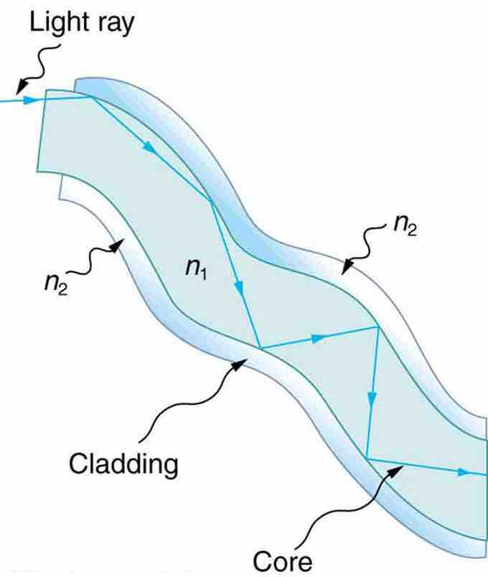
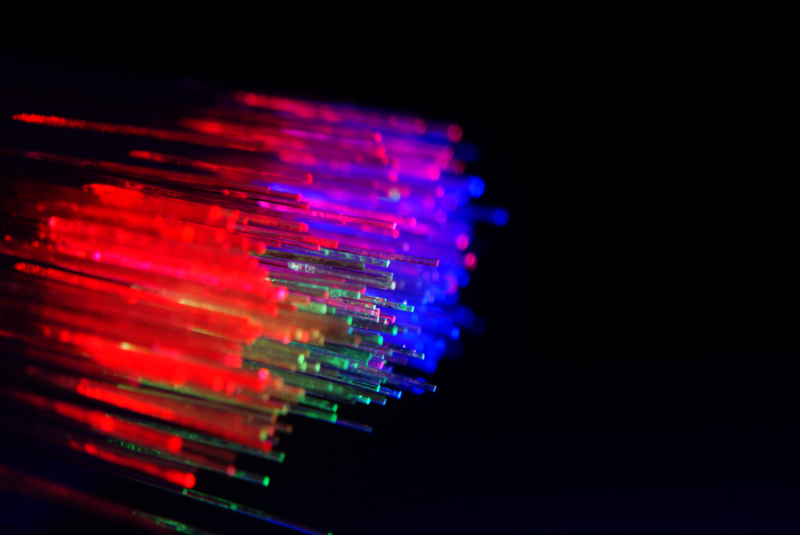
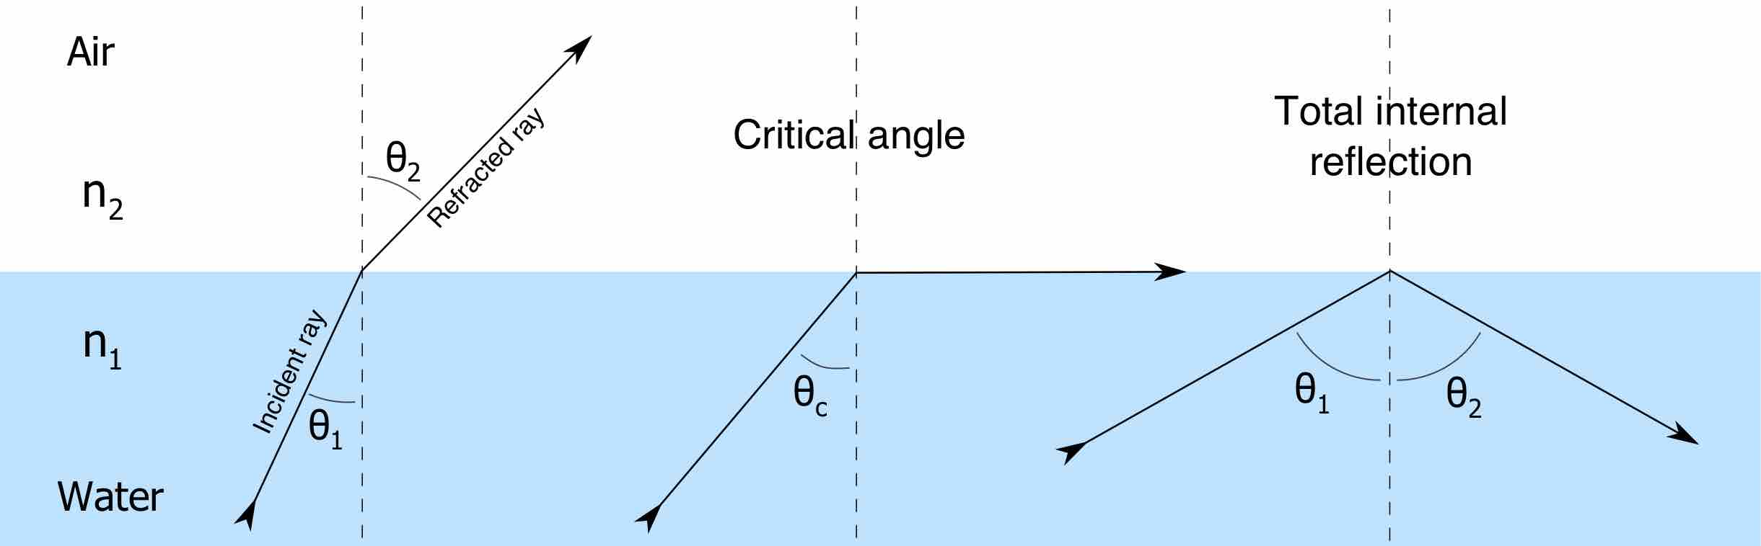
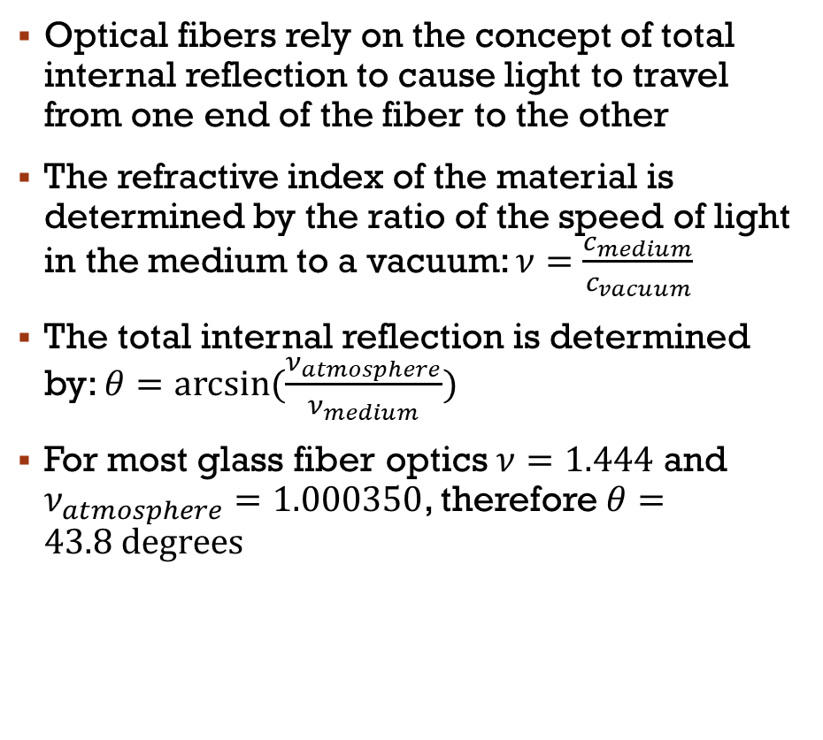
Optical Fibers as Sensors (1)
Optical fibers rely on the concept of total internal reflection to cause light to travel from one end of the fiber to the other
The refractive index of the material is determined by the ratio of the speed of light in the medium to a vacuum: $ν=\frac{c_{medium}}{c_{vacuum}}$
The total internal reflection is determined by: $θ=arcsin(\frac{ν_{atmosphere}}{ν_{medium}})$
For most glass fiber optics $ν=1.444$ and $ν_{atmosphere}=1.000350$, therefore $θ=43.8 degrees$
Notes:
https://www.flickr.com/photos/brixendk/4349817216
Note that $ν_{atmosphere}=1.000350$, which is almost the same as a vacuum ($ν_{vacuum}=1$), so $θ≈arcsin\left(\frac{1}{ν_{medium}}\right)$

Slide 6
Optical Fibers as Sensors (2)
If light strikes the fiber-atmosphere boundary at less than the critical angle it is completely reflected
Imperfections and rough surfaces within the fiber can cause light to be scattered and lost
This loss is made worse when the fiber is bent or deflected
If fibers were embedded in a wrist strap, deflection due to hand movement would cause characteristic changes in the amount of light transmitted
Analyzing the transmitted light levels could allow computers to reconstruct gestures!
“Lost” Light
“Transmitted” Light

Slide 7
Basic setup for Deflection Sensor
LED
Fiber/light medium
Photoresistor / Light Dependent Resistor (LDR)
Photoresistor/LDR
In order to detect the deflection using an LDR, a significant amount of light must be lost when the fiber is bent
35mm fiber length was determined to be the minimum for a noticeable light deflection when bent
LED

Slide 8
PROJECT METHODOLOGY
Phase 1:
Proof of Concept
Phase 2:
Prototype
Determine best material
Phase 3:
Data Analysis
Create a wearable band
Determine best shape
Add sensors
Measure how light levels are impacted by gestures
Determine color of LED light
Develop data collection method
Uniquely identify different a selection of gestures
Automate process

Slide 9
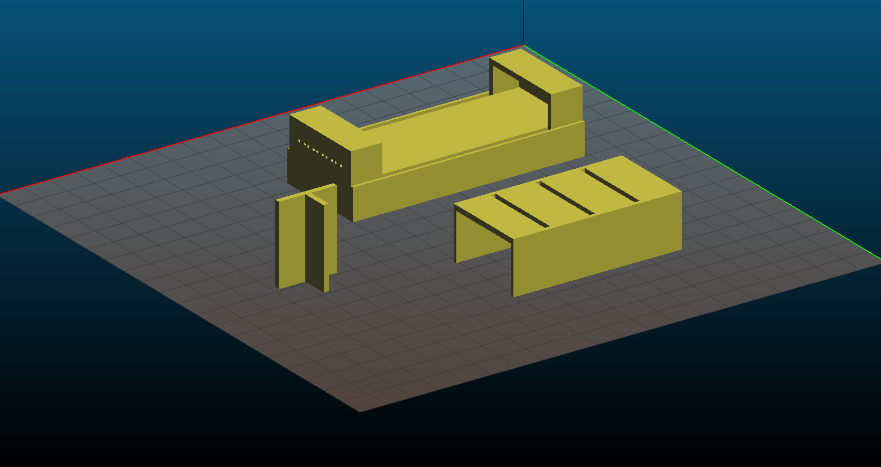
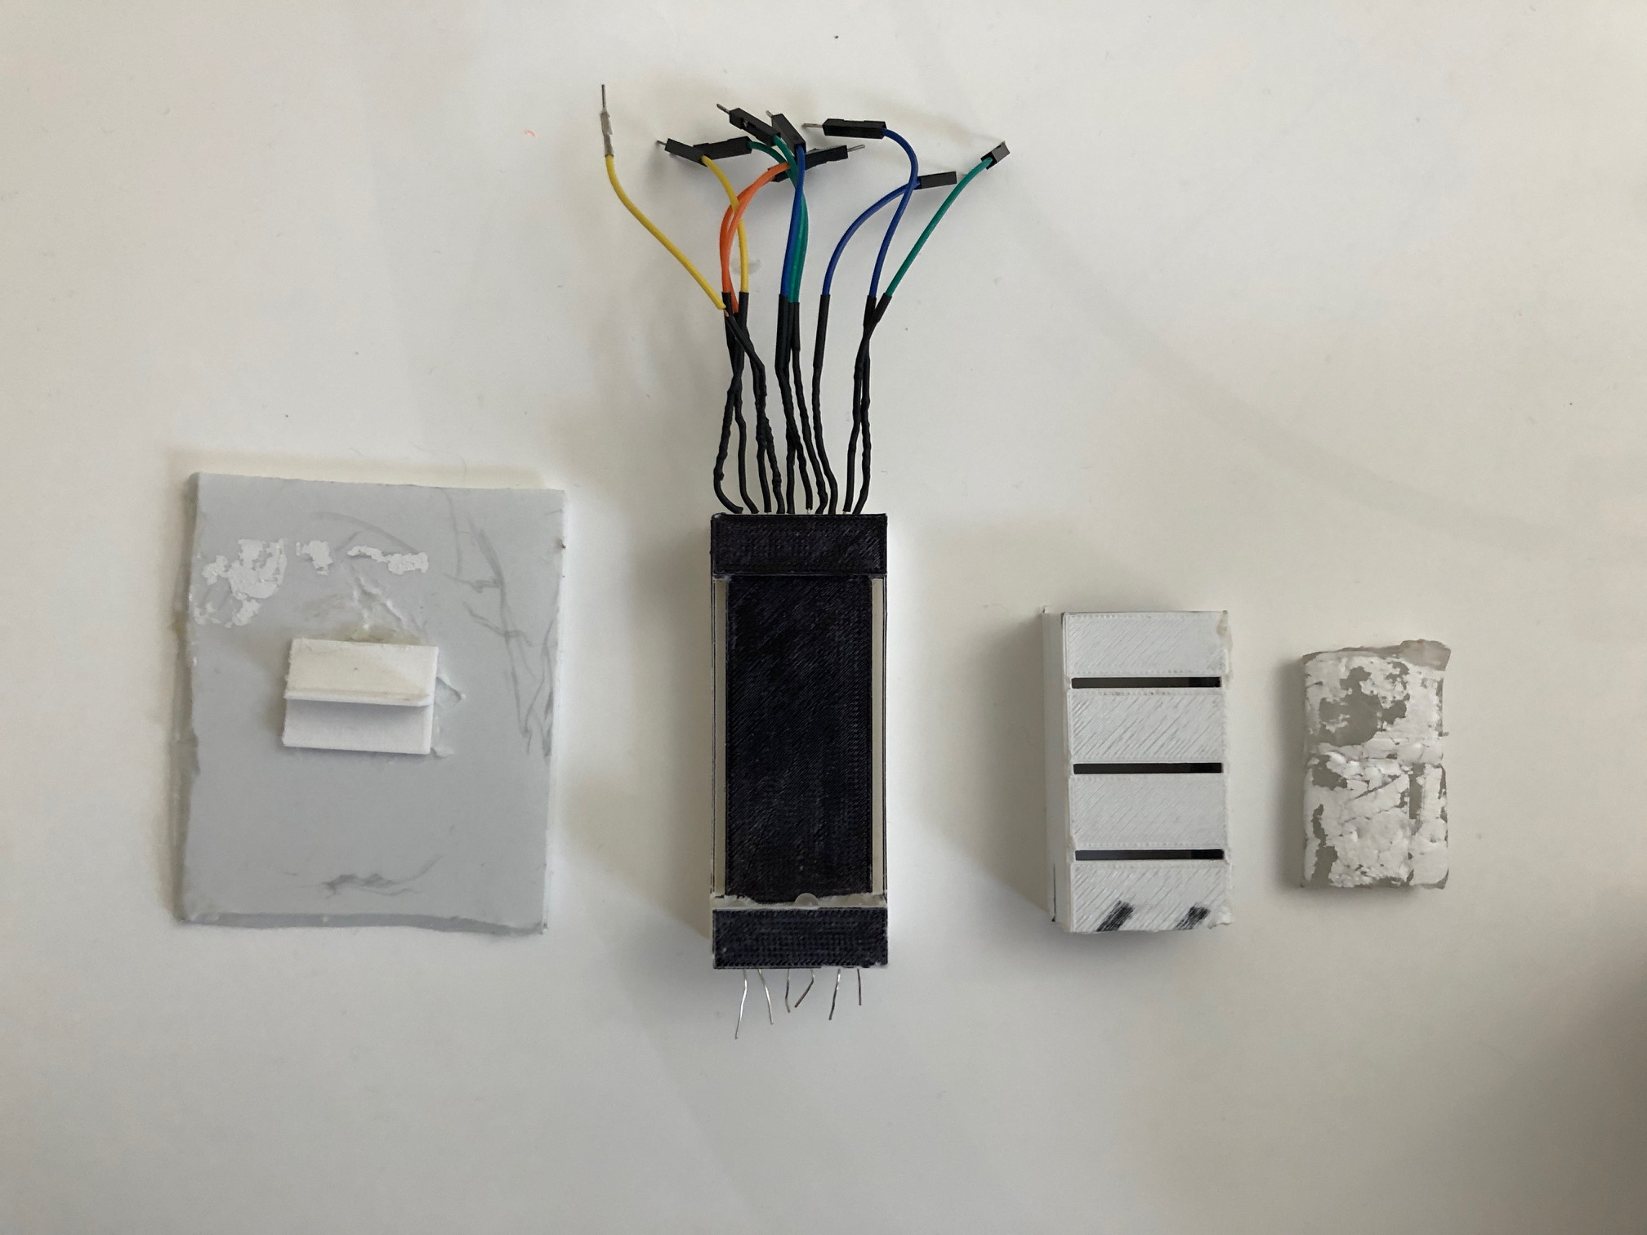
PHASE 1: Proof of CONCEPT
HARDWARE
Holder
Designed a hard casing using SolidWorks to test concept
3D Printed design for consistency and durability
Key features
A holder for the medium to be placed in
Lid to eliminate external light and isolated LED light
Holder for LED and LDR on each end
Plastic tool for consistent depression of medium
Lid
Tool
LDR
Tool
Holder
Lid
Medium
LED

Slide 10
PHASE 1: Proof of concept
Colour | Medium/Fibre material | Minimum Intensity | Maximum Intensity | delta Intensity
Large blue | Humimic #2 | 160 | 990 | 830
Large red | Humimic #2 | 183 | 1013 | 830
Large white | Humimic #2 | 205 | 1021 | 816
Small red | Humimic #2 | 180 | 977 | 797
Large red | Earth's atmosphere | 235 | 996 | 761
Large yellow | Humimic #2 | 210 | 971 | 761
Small green | Humimic #2 | 189 | 937 | 748
Large blue | Earth's atmosphere | 228 | 957 | 729
Large green | Humimic #2 | 185 | 850 | 665
Small red | Earth's atmosphere | 245 | 864 | 619
Small green | Earth's atmosphere | 253 | 775 | 522
Large green | Earth's atmosphere | 240 | 720 | 480
Light Colors Tested
The optimal wavelength of the Light Dependent Resistor (LDR) Large red (630nm) and large blue (460nm) LEDs were determined to be the best (had the greatest delta intensity when depressed).
Red was chosen due to availability.

Slide 11
PHASE 1: proof of concept
Mediums Tested
Fiber Shapes
Standard optical fiber
Could not measure any light deflection
Ecoflex – an opaque silicone
Too opaque and did not permit any light from the LED to pass
Humimic gel – a transparent synthetic gelatin
Too soft. Melted even at body heat
Vytaflex – a semi-transparent urethane rubber
Worked the best.
Tube Molding Material | Pros | Cons
Shrink tube (20mm, 5mm, 4mm) | Somewhat easy to obtain, many sizes | Material stuck to sides Did not mould well
3D Printed Tube (2mm, 4mm, 5mm) | Customizable | Material stuck to sides Material could not be removed
Straw Mold Tube (3mm, 5mm) | Easy to obtain 3mm proved to be best for LED shape and resolution
Rectangular | Easier to fabricate | sensors have to be embedded = fragile
Sinusoidal | Degree of light path independence between sensors | Sensors have to be embedded = fragile

Slide 12
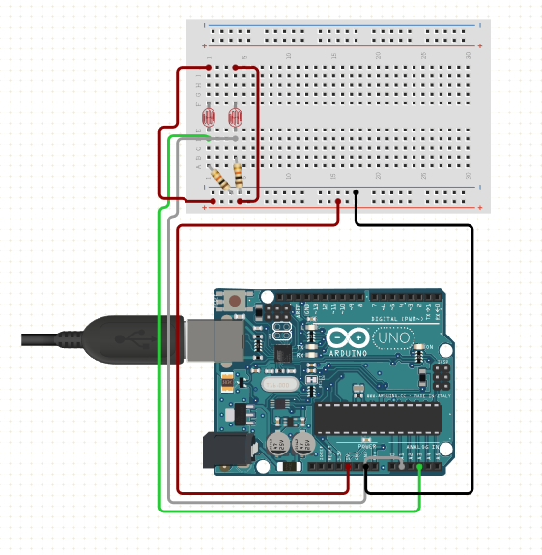
PHASE 2: prototype HARDWARE
Three 35mm and two 80mm Vytaflex fibers molded using 3mm straw
Large red (630nm) LEDs
LEDs and LDRs are fastened using heat shrink to the fiber
1 Arduino Uno
5 LDRs and 5 72.5k Ohm resistors
LED circuit: 9V battery, 5V regulator, 50 ohm resistor, 100 ohm resistor, Ohms resistors, 5 LEDs
LDRs
35mm fibers
80mm fibers
LEDs
~1cm separation between fibers

Slide 13
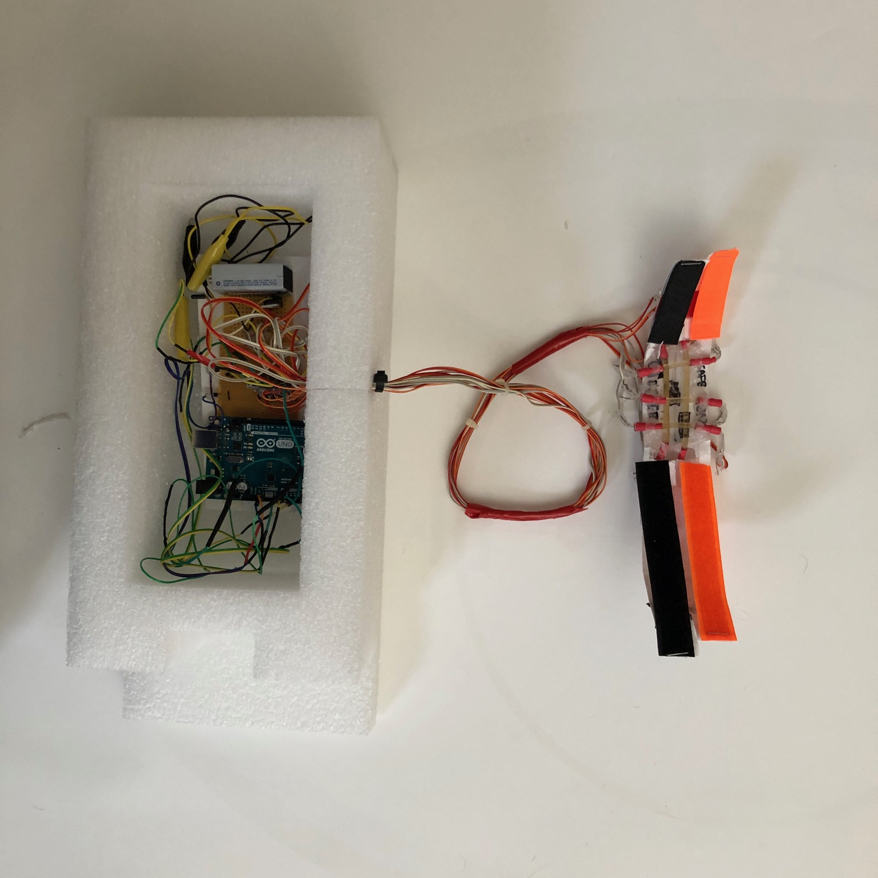
PHASE 2: ACTUAL HARDWARE SETUP
Setup on the previous slide is mounted with Velcro bands
The band is placed on the wrist
The Arduino is used to collect data
Code written in Python and C++
Wrist strap
Arduino

Slide 14
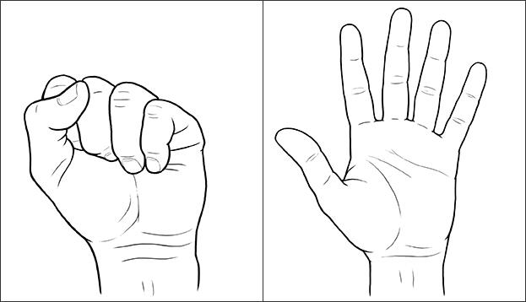
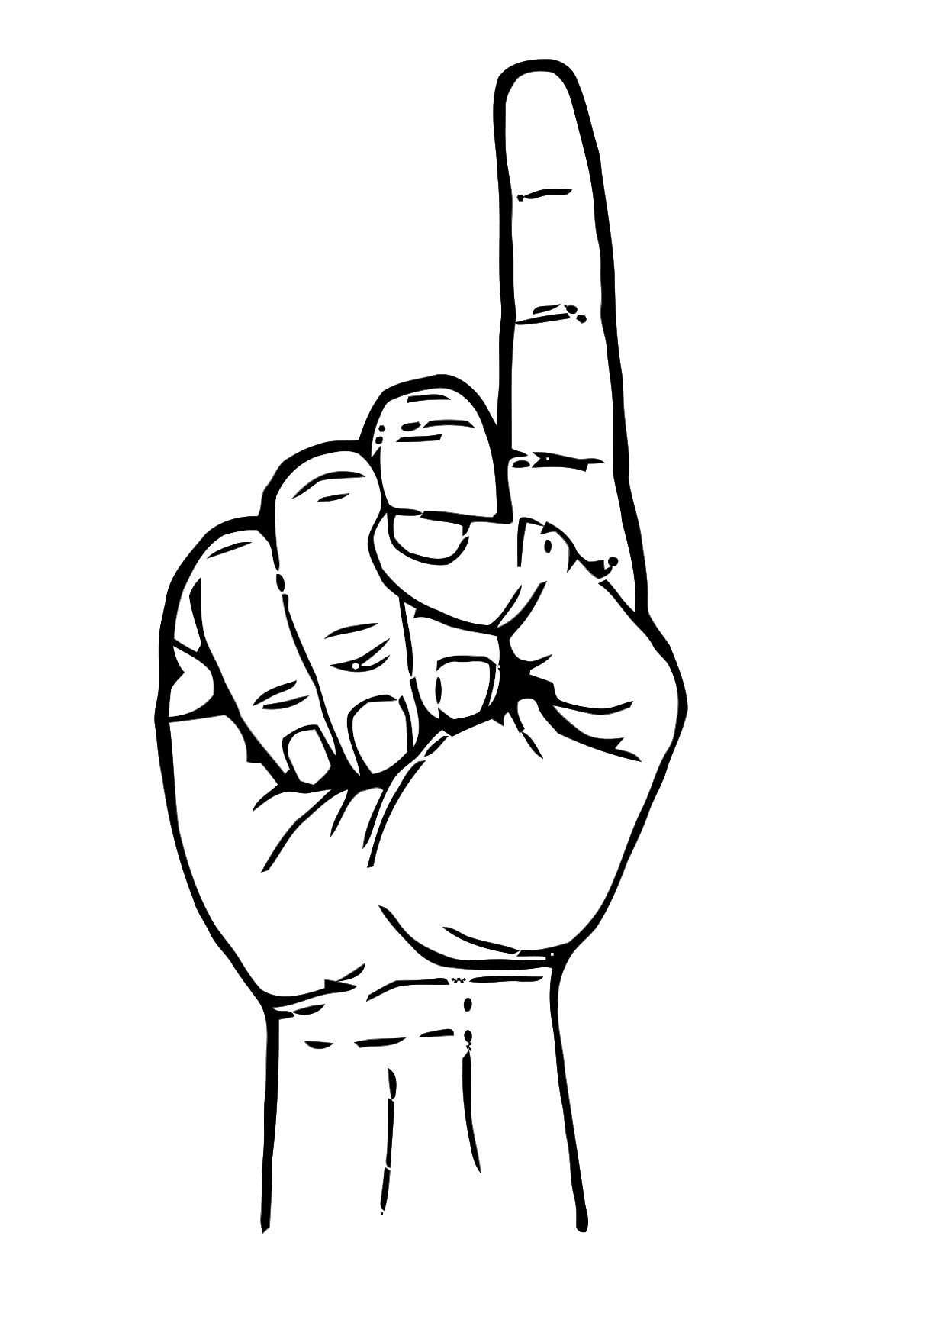
PHASE 2: Gestures tested
A large collection of gestures can be tested using the prototype
I focus this presentation on three gestures
Finger Extension [Extend]
Finger Flexion
[Fist]
One Finger
[One]

Slide 15
PHASE 3: DATA ANALYSIS
Light Intensity over Time
5 seconds of data was collected for each gesture
Includes a brief relax and transition period before and after gesture
Approximately 1 reading per 0.02s (250 readings/s)
Light intensity in scaled units (0 to 1023) based on the voltage drop due to the LDR (0 to 5V)
Manually Determine Hand Position
Moving Averages vs. Original
Compute the Gestures
Compare

Slide 16
PHASE 3: Data ANALYSIS [one finger]
Relax position
One finger position
Each sensor (LDR) has its own unique baseline intensity value
Each sensor need to be calibrated to a specific value separately
Each sensor detects the change in intensity when hand gestures are made

Slide 17
PHASE 3: Identifying a Single Gesture
Readings of two sensors “normalized” by subtracting the average value of their readings (i.e. centering graph around value of 0)
Some sensors react more significantly to specific gestures
Sensor 5 detects the deflection more intensely than sensor 1
By examining the magnitude of the change across all sensors, a unique pattern can be determined for each type of gesture
Notes:
Normalized Light Intensity

Slide 18
Phase 3: Data analysis [Different Gestures xxx]
FINGER EXTENSION [EXTEND]

Slide 19
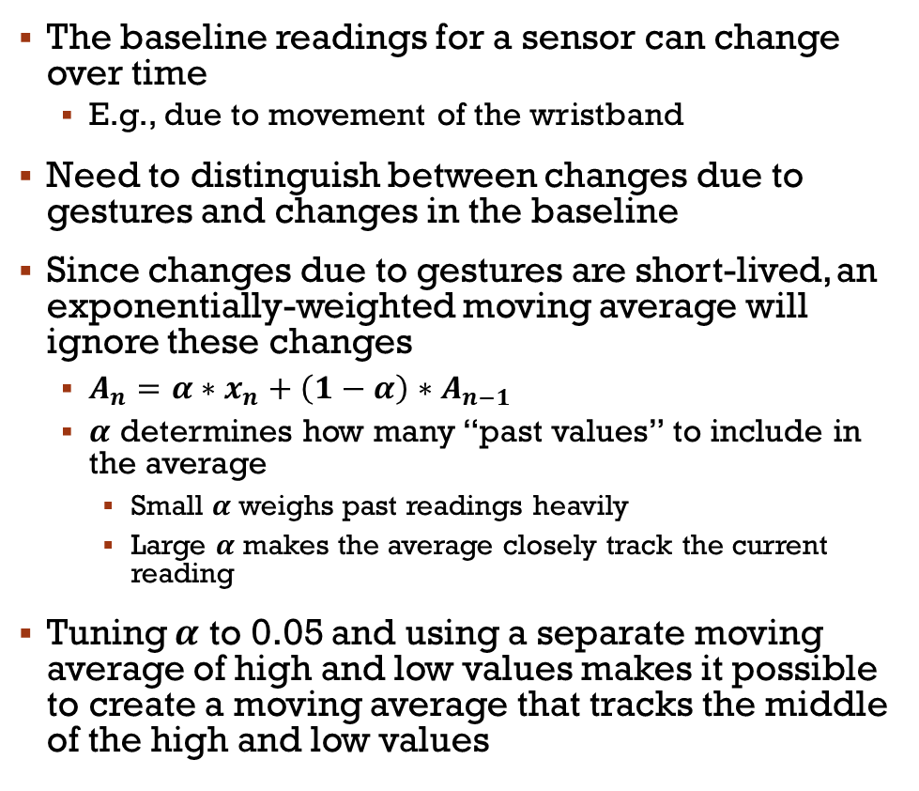
PHASE 3: Handling Changing Readings
The baseline readings for a sensor can change over time
E.g., due to movement of the wristband
Need to distinguish between changes due to gestures and changes in the baseline
Since changes due to gestures are short-lived, an exponentially-weighted moving average will ignore these changes
$A_{n}=α∗x_{n}+\left(1−α\right)∗A_{n−1}$
$α$ determines how many “past values” to include in the average
Small $α$ weighs past readings heavily
Large $α$ makes the average closely track the current reading
Tuning $α$ to 0.05 and using a separate moving average of high and low values makes it possible to create a moving average that tracks the middle of the high and low values

Slide 20
Labelling the data
Compare individual moving averages to original
Time of determined maximum
Time of determined transition
Time of determined minimum

Slide 21
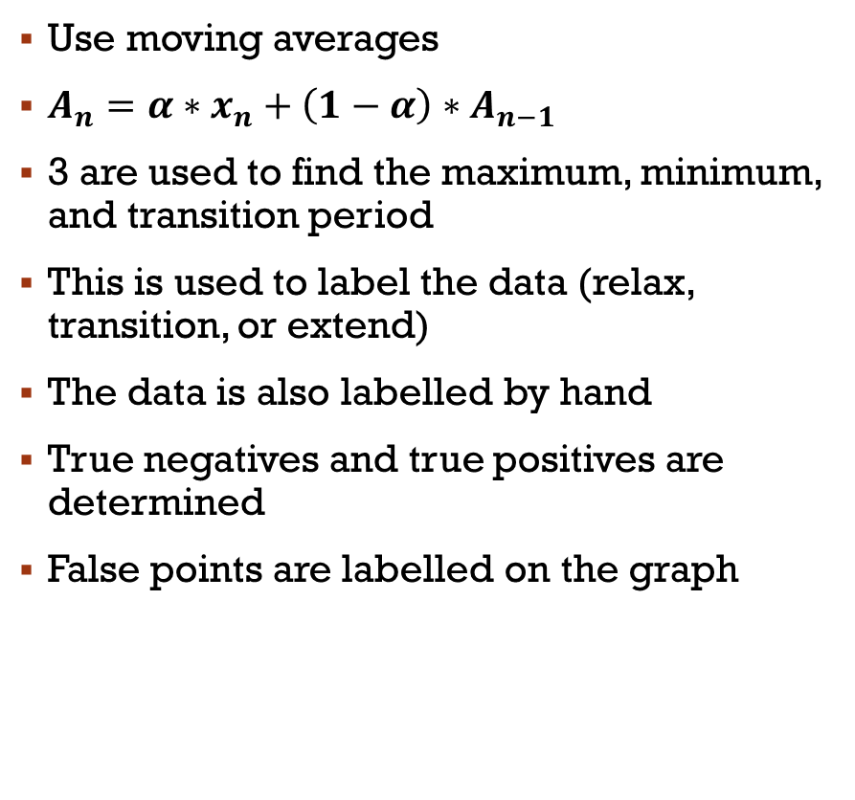
Phase 3: data analysis [Extend] Labelling the data
Use moving averages
$A_{n}=α∗x_{n}+\left(1−α\right)∗A_{n−1}$
3 are used to find the maximum, minimum, and transition period
This is used to label the data (relax, transition, or extend)
The data is also labelled by hand
True negatives and true positives are determined
False points are labelled on the graph

Slide 22
Handling a mixture of gestures
The order of the gestures tested was: extend → fist → one done twice
Labelled manually as the gesture, relax, or transition
Relax time period
Extend period
Fist period
Transition period
One period

Slide 23
Fingerprinting the data
look
 | 1 | 2 | 3 | 4 | 5
extend |  | -25 | -80 | -200 | -10
fist |  | -25 | -25 | -30
one |  | 0 | -10 | -30

Slide 24
ConclusionS and next steps
Fiber optics is a practical method of detecting deflection in the wrist
The project is a promising first step in creating a light-weight assistive technology
The next step of the project is to increase the number of gestures recognized and compete the machine learning training on the data to auto-detect gestures
The final design for the wrist strap will be to have the system in a watch band and powered by a smart watch rather than an Arduino

Slide 25
code
int sensorPin = A0; // select the input pin for LDR(s)
int sensorPin2 = A1;
int sensorPin3 = A2;
int sensorPin4 = A3;
int sensorPin5 = A4;
int sensorValue = 0; // variable(s) to store the value coming from the sensor
int sensorValue2 = 0;
int sensorValue3 = 0;
int sensorValue4 = 0;
int sensorValue5 = 0;
void setup() {
Serial.begin(9600); //sets serial port for communication
pinMode(LED_BUILTIN, OUTPUT);
}
void loop() {
sensorValue = analogRead(sensorPin); // read the value(s) from the sensor(s)
sensorValue2 = analogRead(sensorPin2);
sensorValue3 = analogRead(sensorPin3);
sensorValue4 = analogRead(sensorPin4);
sensorValue5 = analogRead(sensorPin5);
Serial.print(sensorValue); //prints the values coming from the sensors on the screen
Serial.print(",");
Serial.print(sensorValue2);
Serial.print(",");
Serial.print(sensorValue3);
Serial.print(",");
Serial.print(sensorValue4);
Serial.print(",");
Serial.println(sensorValue5);
}
C++ Arduino Code

Slide 26
code
Python data collector:
#!/usr/bin/python
import serial
import time
import sys
# Determine the file to save data to and Arduino port
fileOut = sys.argv[2]
port = sys.argv[1]
f = open(fileOut, "w")
# Open Arduino serial
ser = serial.Serial(port, 9600, timeout=1)
def getData(timeout, label):
# measure delta time of a single gesture cycle for timeout
timeI = time.time()
while time.time()-timeI < timeout:
Python data collector

Slide 27
code
try:
reading = ser.readline() # Read sensor values from Arduino
# Record delta Time, Unix time, ldr readings, and label to a file
data = [0,0,0,0,0,0,0,""]
data[0] = time.time()-timeIA
data[1] = time.time()
data[2] = int(reading.split('\n')[0].split(",")[0])
data[3] = int(reading.split('\n')[0].split(",")[1])
data[4] = int(reading.split('\n')[0].split(",")[2])
data[5] = int(reading.split('\n')[0].split(",")[3])
data[6] = int(reading.split('\n')[0].split(",")[4])
data[7] = label
for i in data:
print str(i)+",",
f.write(str(i)+",")
print ""
f.write("\n")
except:
pass
Python data collector cont.

Slide 28
code
Python data collector:
gestures = ["extend","fist","one"]*2 # declare labels of which gestrues are being tested
print("delta Time, Unix Time, pr1, pr2, pr3, pr4, pr5, label") # file headers
f.write("delta Time, Unix Time, pr1, pr2, pr3, pr4, pr5, label\n")
# Collect data for each gesture cycle for 5.0s
timeIA = time.time()
for gesture in gestures:
continueQ = raw_input("Do "+gesture+"? [Y/n]: ")
if continueQ == "y" or continueQ == "" or continueQ == "Y":
getData(5.0, gesture)
elif continueQ == "n" or continueQ == "N":
continueQ = "n"
f.close()
Python data collector cont.

Slide 29
bIBLIOGRAPHY

Slide 30
Possible questions
Why light as sensors? What else could you have used?
Cost?
Why only 3 gestures? How many more can you detect?
What else can this be used for?
Why is this important to have?

Slide 31
Photo credit
https://orthoinfo.aaos.org/en/diseases--conditions/carpal-tunnel-syndrome/
https://www.semanticscholar.org/paper/Wrist-worn-hand-gesture-recognition-based-on-Zhu-Jiang/f4e96b4b658e21c42e32993df63a6d0798c41cdc/figure/1
https://thegadgetflow.com/wp-content/uploads/2016/08/Tap-Strap-Wearable-Keyboard-008.jpg
http://hyperphysics.phy-astr.gsu.edu/hbase/optmod/fibopt.html
http://oer2go.org/mods/en-boundless/www.boundless.com/physics/textbooks/boundless-physics-textbook/geometric-optics-24/reflection-refraction-and-dispersion-169/total-internal-reflection-and-fiber-optics-609-6258/index.html

Slide 32
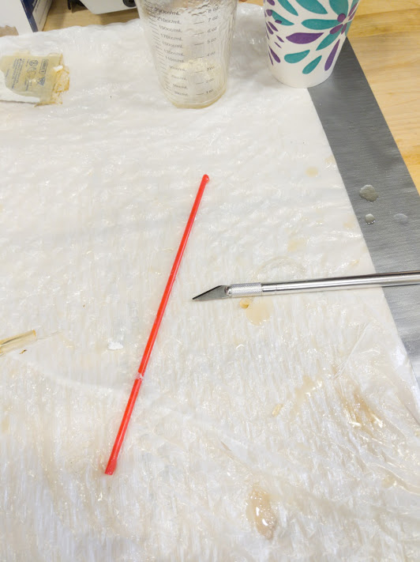
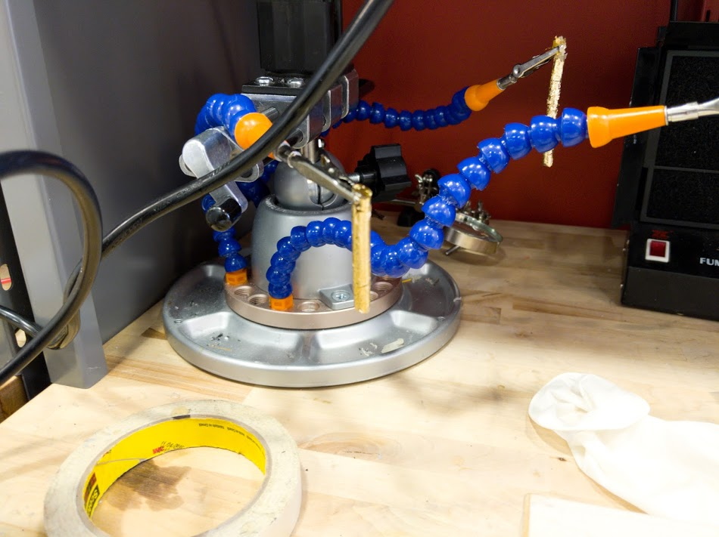
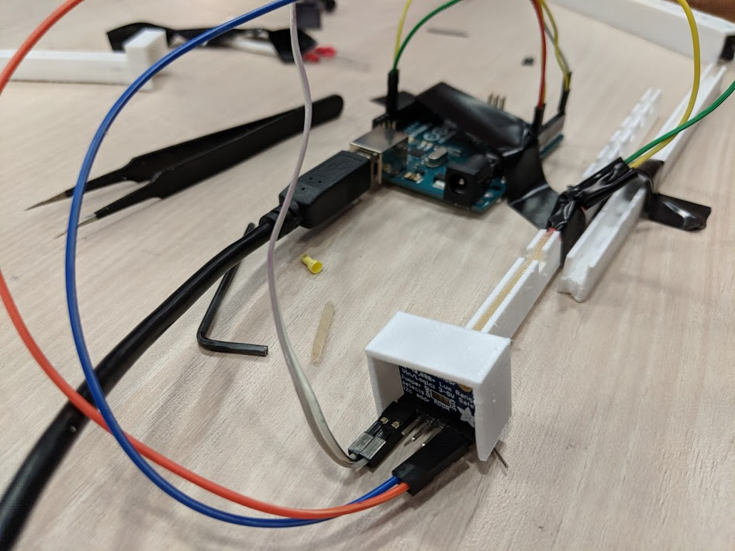
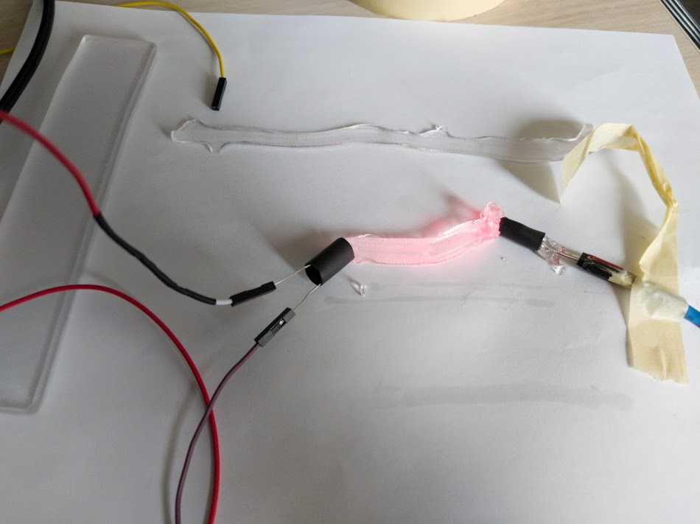
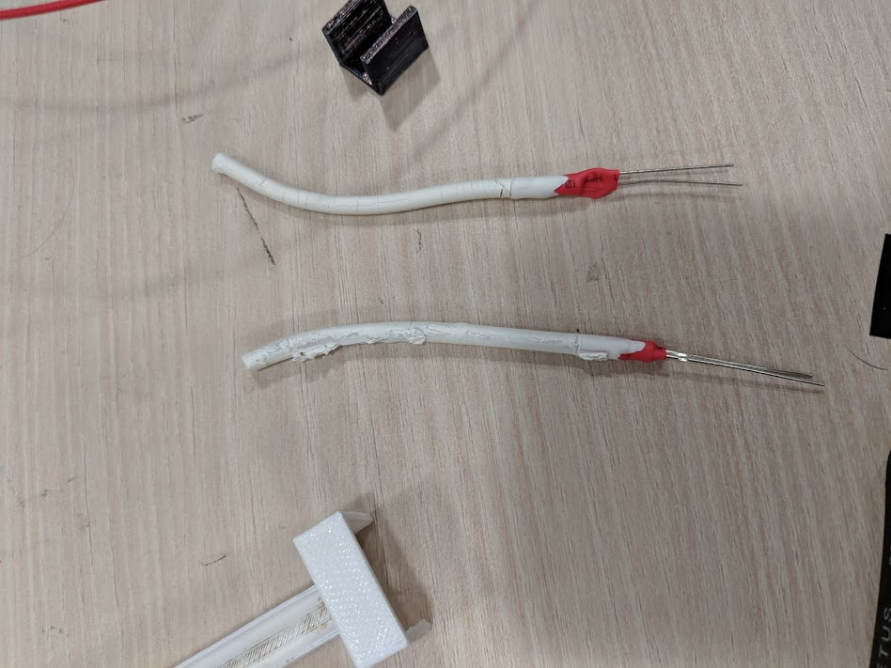

Slide 33
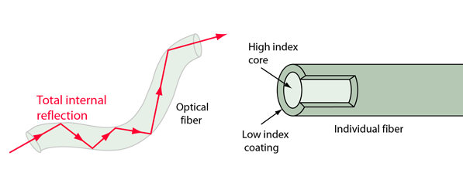
Fiber optics
This is ideally less than the critical angle allowing light to be lost.
The refractive index of these materials cannot be measured without special equipment, but it can be used to understand the loss of light in the fiber
In my setup the cladding is simply Earth’s atmosphere

Slide 34
LED Color xxx makes no sense
The optimal wavelength of the LDR must be determined
This does not depend on the material used
Humimic was used as a constant baseline due to its transparency
A 3d printed cast was used to eliminate external light
A constant depression was used to determine minimum intensity
Large red (630nm) and large blue (460nm) LEDs were determined to be the best. Red was chosen due to availability.
Colour | Medium | Minimum Intensity | Maximum Intensity | delta Intensity
Large blue | Humimic #2 | 160 | 990 | 830
Large red | Humimic #2 | 183 | 1013 | 830
Large white | Humimic #2 | 205 | 1021 | 816
Small red | Humimic #2 | 180 | 977 | 797
Large red | Earth's atmosphere | 235 | 996 | 761
Large yellow | Humimic #2 | 210 | 971 | 761
Small green | Humimic #2 | 189 | 937 | 748
Large blue | Earth's atmosphere | 228 | 957 | 729
Large green | Humimic #2 | 185 | 850 | 665
Small red | Earth's atmosphere | 245 | 864 | 619
Small green | Earth's atmosphere | 253 | 775 | 522
Large green | Earth's atmosphere | 240 | 720 | 480

Slide 35
Key Questions
Pre Test
What type of fiber material would work well?
Must have imperfections that cause light loss due to deflection
Must have consistent, reproduceable behavior
What type of light should be transmitted?
The LDR sensors work best with different light colors/wavelengths
What shape of fibers work best?
Full prototype tests
How are light levels impacted by different gestures?
Can we uniquely identify different gestures using this approach?

Slide 36
Materials/Mediums proposed
Standard optical fiber
Vytaflex – a semi-transparent urethane rubber
Ecoflex – an opaque silicone
Humimic gel – a transparent synthetic gelatin
Xxx why these 4?

Slide 37
WHY WOULD IT WORK?
Transverse carpal ligament area
Deflection occurs when fingers [tendons] are moved
Magnitude of deflection of different tendons can be used to identify gestures
6 different tendons in wrist
How to measure deflection accurately?
Must measure all tendons and measure tiny (< 1 mm) movement
Deploy a set of sensors across a watch strap
Notes:
https://www.extremetech.com/mobile/285724-1-in-6-us-adults-now-own-a-smartwatch
https://arstechnica.com/gadgets/2019/09/apple-watch-series-5-hands-on-software-is-king/

Slide 38
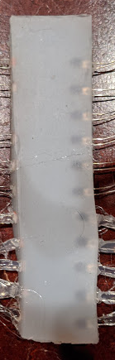
Problems with each material
Optic fibers were too perfect and there was no light deflection, even when bent over 90 degrees.
The internal reflection is too high
A non-ideal optical fiber is needed so that light is lost when bent
Ecoflex was too opaque and did not permit any light from the LED to pass
Humimic was too soft and melted/tore due to the body heat.
Humimic melts at about 50 degrees; body heat is about 40
XXX what worked and how well…

Slide 39
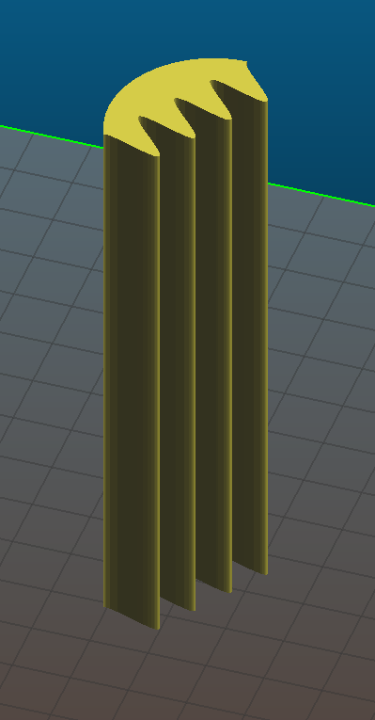
Different shapes tested
Tube
Shrink tube: 20mm, 5mm, 4mm
3d print: 2mm, 4mm, 5mm
Straws: 3mm, 5mm
Sinusoidal → manufactured by first casting a mold using Vytaflex (Silicone)
Rectangular
Minimize the diameter to keep multiple strands for higher resolution
Sinusoidal and Rectangular molds required sensors to be embedded = fragility
Shrink tube and 3d printed molds caused capillary action (the material stuck to the sides)
Straws proved to be the best mold – 3mm proved to be best for LED shape and resolution

Slide 40
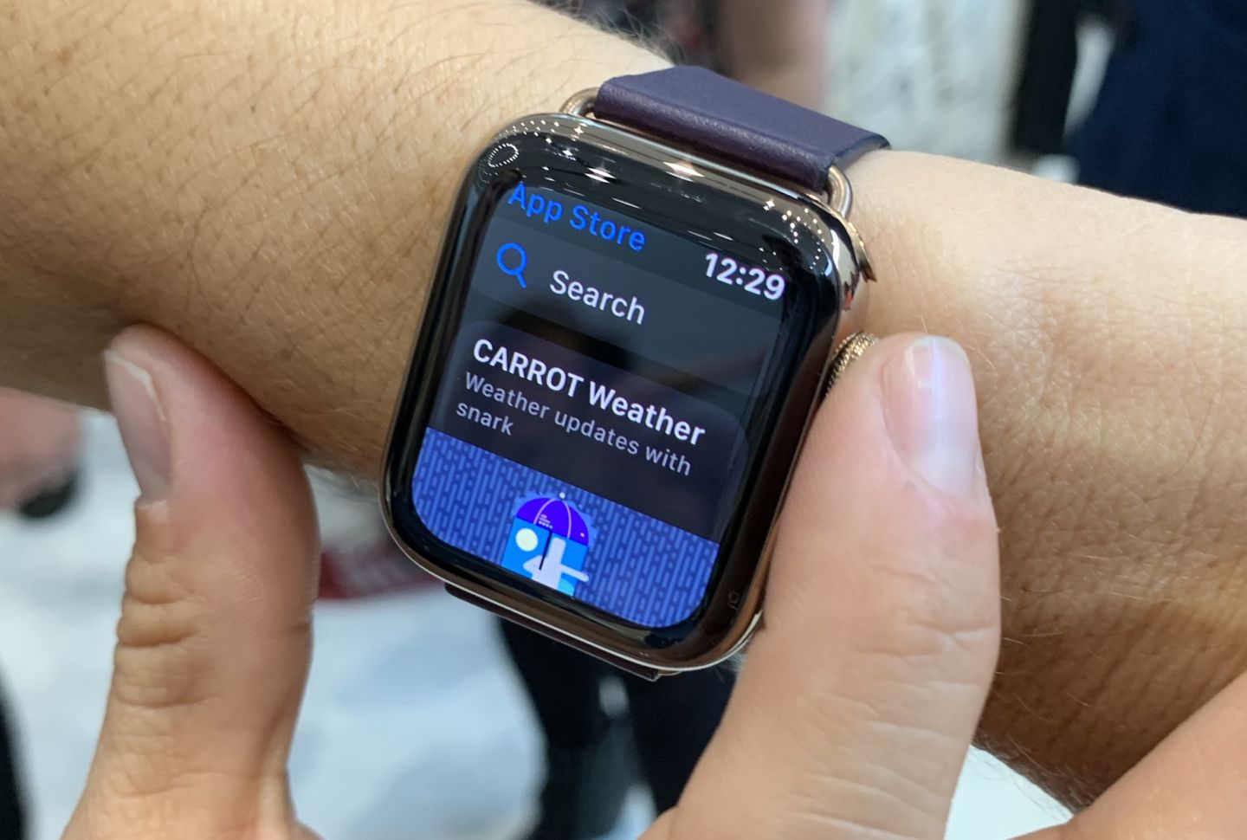
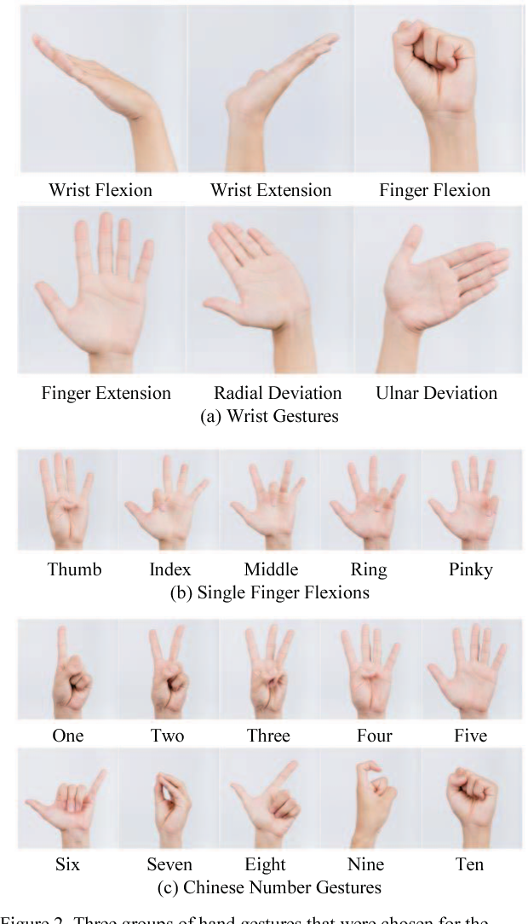
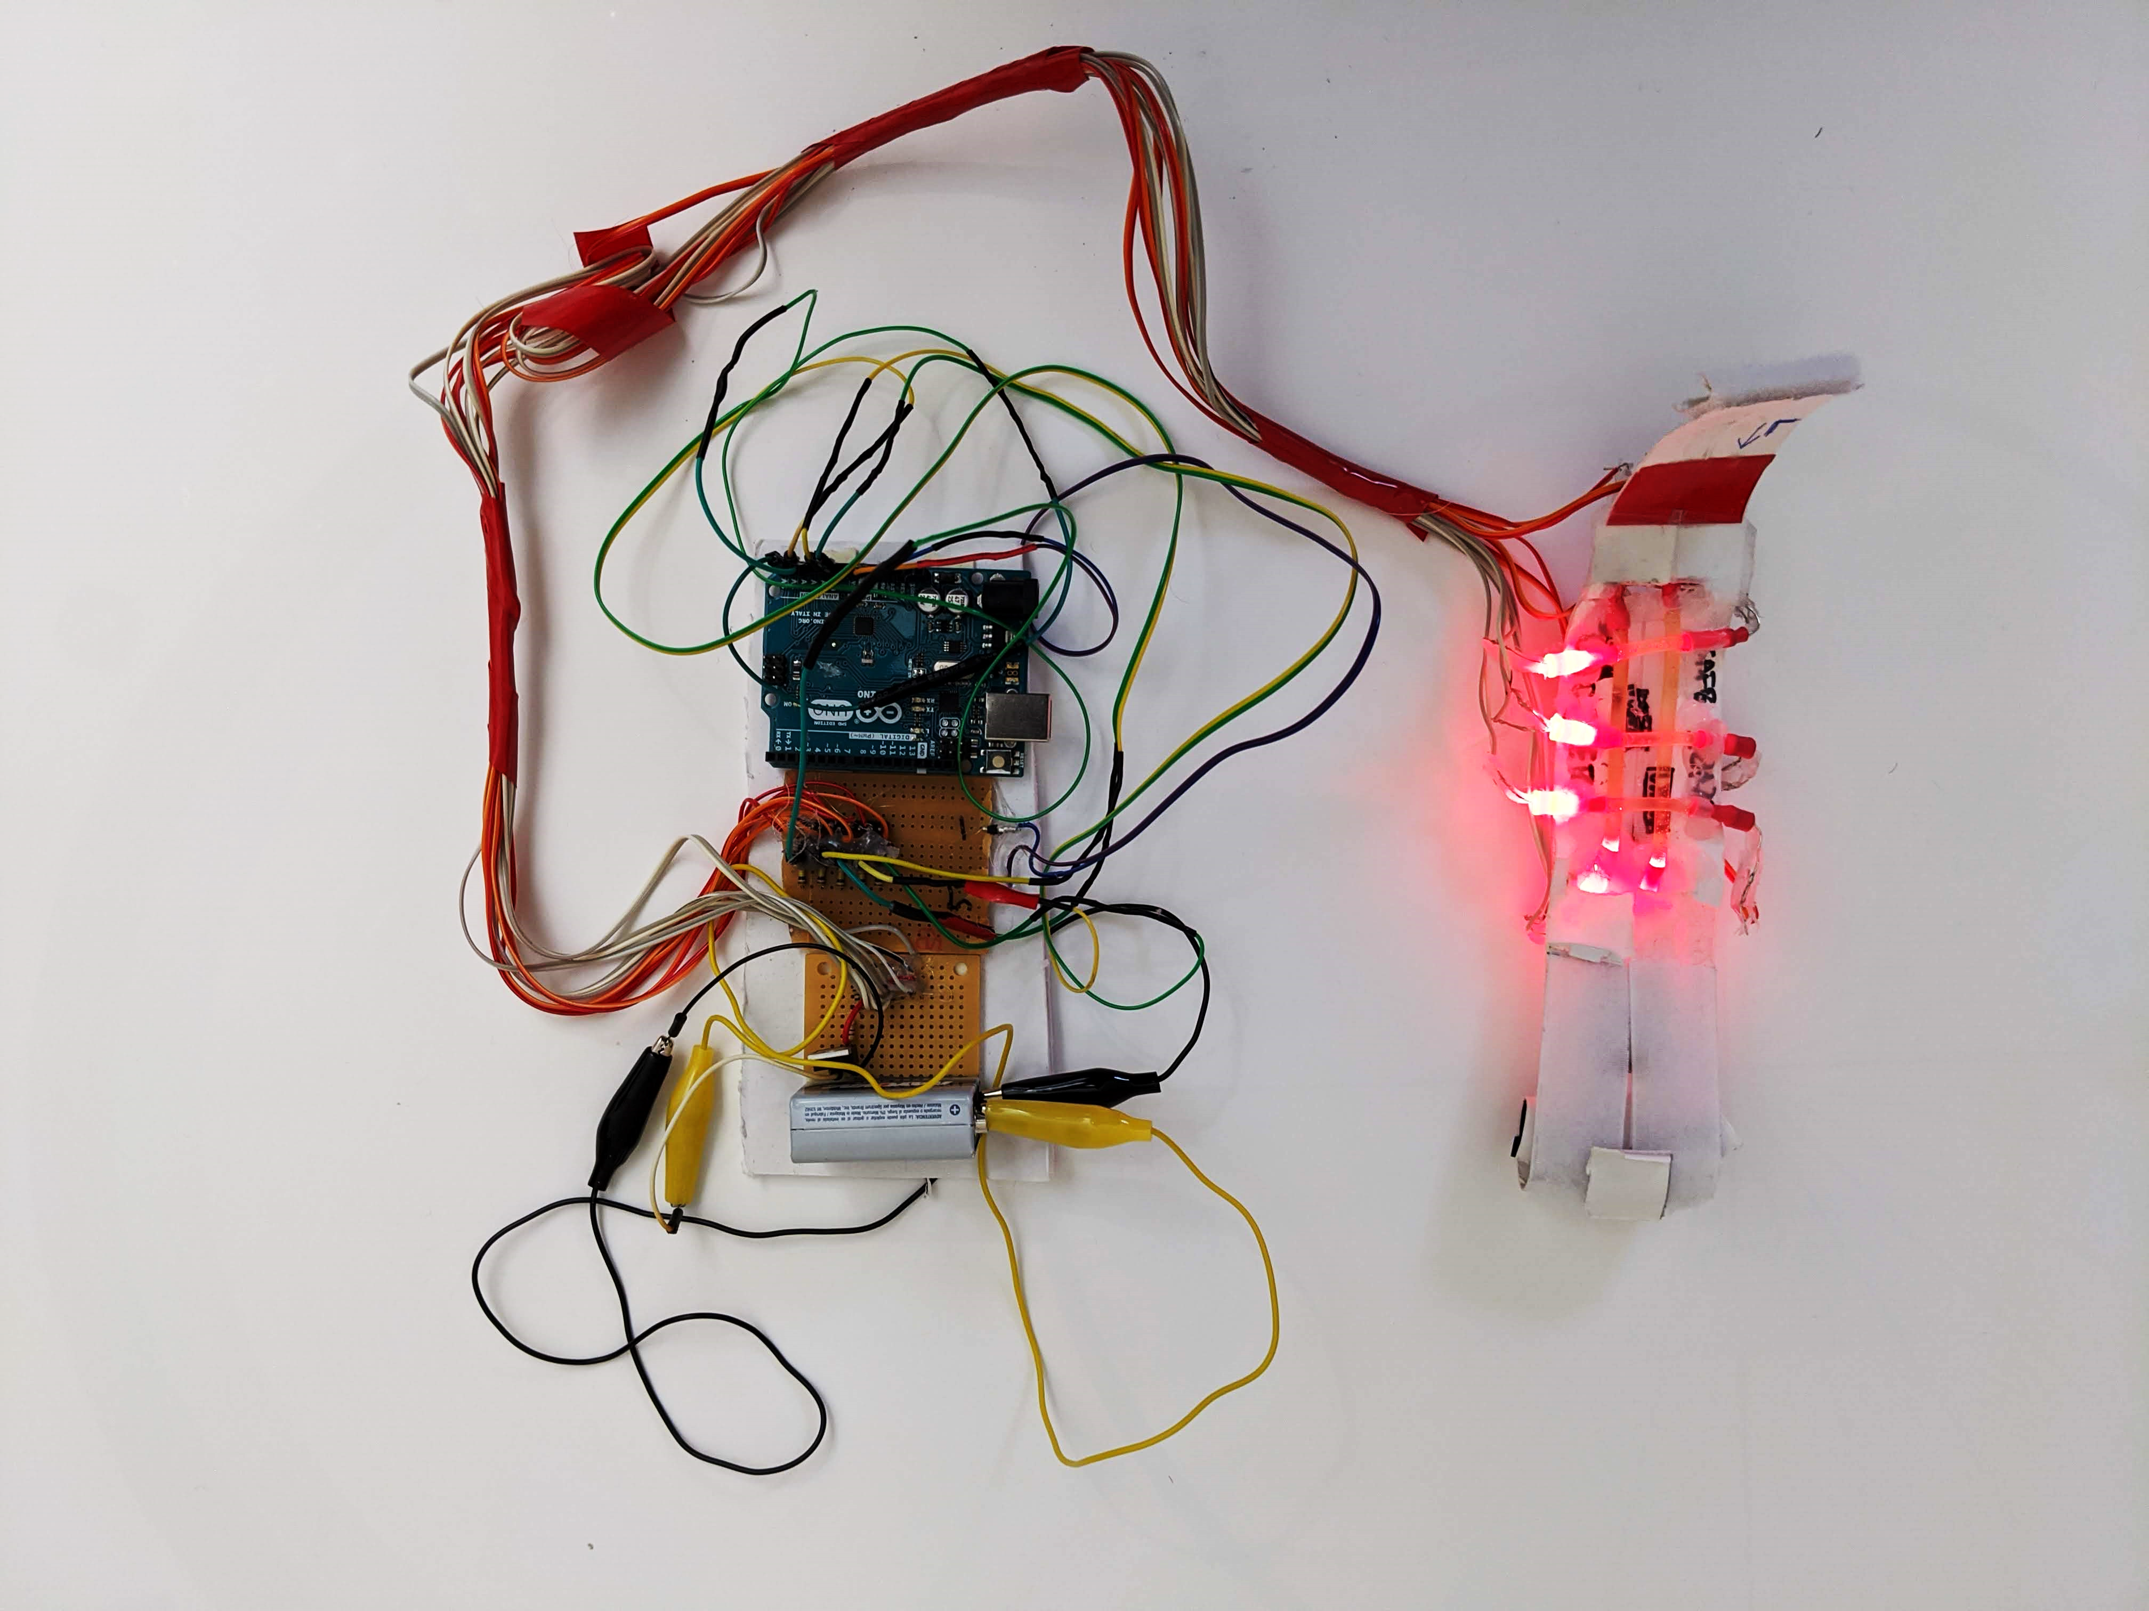
Measure left to right and up and down on hand
35mm fibers vertically and 80mm horizontally

